Slide 1
Secondary Sales
Jyothi Laboratories Ltd.

Slide 2

Company Overview
Leading IT Solutions and Services Provider.
An ISO 9001:2008 Certified Company.
Rated by CRISIL as CRISIL SE 1B.
25 years of Industry Presence.
More than 3000 Customers
1300+ Employees.
Revenue of over 242 Crores.
Global Presence.
Strong Service Delivery Infrastructure.

Slide 3
Orient Enterprise Division
Customer Focused
Proven Track Record
Regionalization expertise
Highly Skilled Professionals
Onsite/ Offsite Software Development
Proven Proficiency Providing Business Critical and Distributed Transaction Solutions
Integration Services Supporting Varied Vendors and Platforms for complete Enterprise Application Integration Solutions
Domain Expertise in Banking, Airlines, Travel, IT, Entertainment Manufacturing, Sales and Distribution, Retail and Healthcare Industries

Slide 4
Our Services
Add Value To Jyothi Laboratories
Work closely with the Customers, With Product, Technology and Implementation teams for key opportunities
Complement The Customers with Technology Platform. Support Opportunity Based Customizations and Services
Multiple Verticals
Various Sectors
Special Needs
Regionalization and Flexibility
Accelerated Customer On-boarding
Differentiating Edge
for New Business Opportunities
with Long Term Business Value
and Loyal Customer Base
Pre-sales support
Solutioning
Live Simulation
Never a ‘No’ to a Deserving Customer
No Delays
No Cost Overruns
No Complaints
Customizations
Short Deterministic Timelines
Low Fixed Cost
Extensive Expertise working with Corporate Clients

Slide 5

















Enterprise Solution Customers

Slide 6
About Jyothi Laboratories
Jyothy Laboratories Ltd is a Mumbai-based FMCG company founded in 1983.
The company has 21 manufacturing units at 14 locations across India.
The company originated in Kandanassery, near Guruvayur in Thrissur district of Kerala State by M. P. Ramachandran.
It has 6 business divisions namely Fabric Care (Ujala -. market leader), Household Insecticide (Maxo), Utensil Cleaners (Exo), Fragrances, Personal Care (Margo) and Fabric Care Service.
Ujala, Maxo, Exo, Jeeva and Maya are some of the brands it owns under these divisions. Ujala is the biggest brand in the company portfolio and contributing up to 46% of the company revenues.
The company is the largest player in the fabric whitener space in India with a market share of 72%.
On May 2011 Jyothy Laboratories bought 50.97% stake in Henkel India.

Slide 7
Current Challenges
Two solutions are in use to handle secondary sales
The user base is huge. Approximate 2000+ Distributors, 1200++ Sales Executives and 250+ SKU
The major challenge is recurring license cost
Also mix of SAP, Vendor Applications (Aadhar, Laxya) and around 10+ self developed solution.
Difficulty in maintaining it
Looking for Single Vendor solution with Mobility presence.

Slide 8

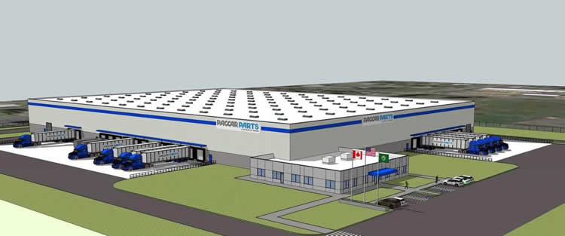
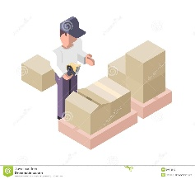
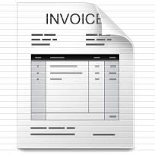


Current Process Flow
Purchase Order
Sales Order
Aadhar Application
Laxya Application
Factory/Mother Warehouse
Distributors
Retailers

Slide 9
Proposed Solution
Web based Secondary Sales with following functionality:
User roles and access rights configuration
Procure to Pay for Distributor
Sales Order booking for retailers and whole-sellers
Sales Return and claims includes damaged stock, expiry stock
Orders uploaded into legacy application via CSV and FTP
Stock visibility for Jyothi Laboratory accords Distributor network
Mobility solution using Android, iOS with following functionality:
User type: Sales Executive, Distributor
Purchase Order Booking, Stock checking, Payment status
Sales Order booking, Invoice status, Payment collection details, Claims

Slide 10



Solution Architecture
Jyothi Laboratory
Odoo Portal
Mobile App
Web based Secondary Sales for Distributor and Data Integration
Web based Data Integration Portal for Mobile Application
Distributor A
Distributor B
Distributor C

Slide 11


Odoo - Solution
Jyothi Laboratory
Sales Executive
Laxmi Soaps
Handmade Soaps
Distributor Warehouse
Distributor Warehouse
Users
Users

Slide 12
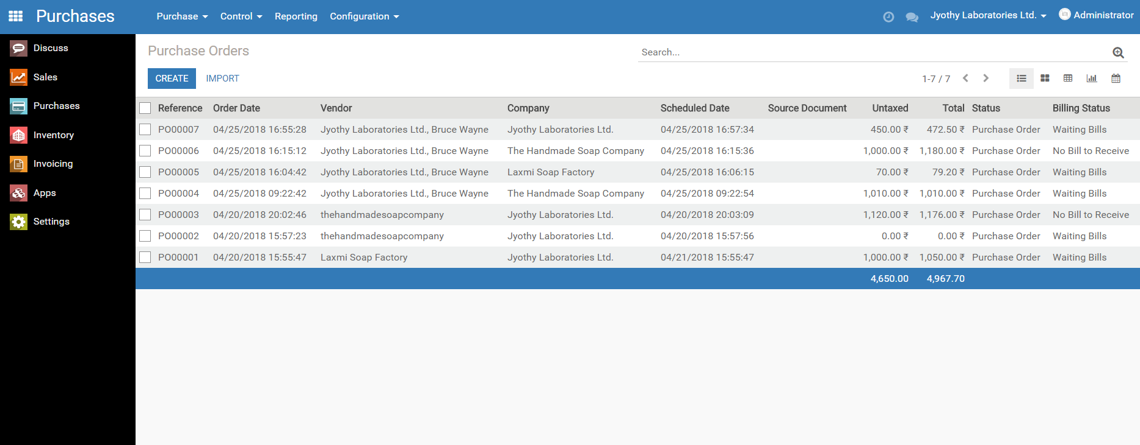
Odoo - Procurement

Slide 13
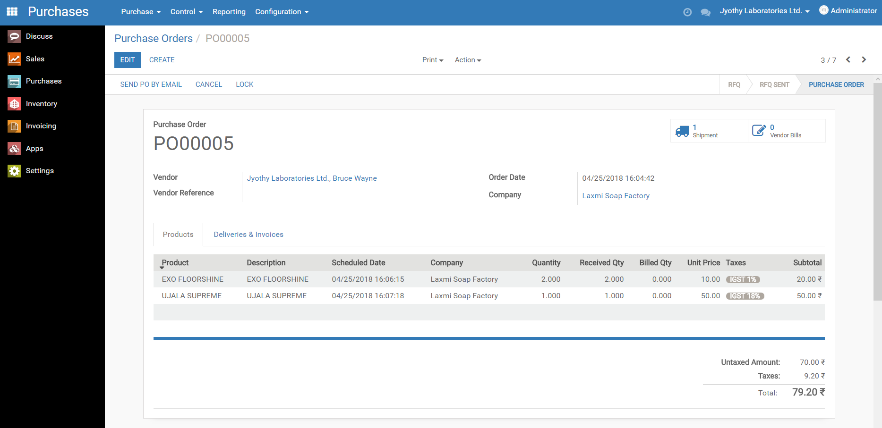
Odoo - Procurement

Slide 14
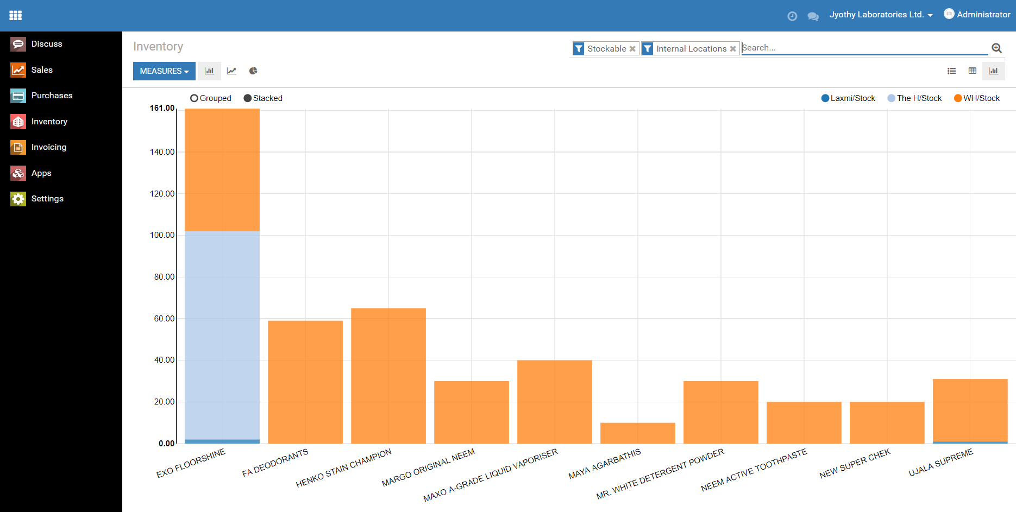
Odoo – Inventory Stock

Slide 15
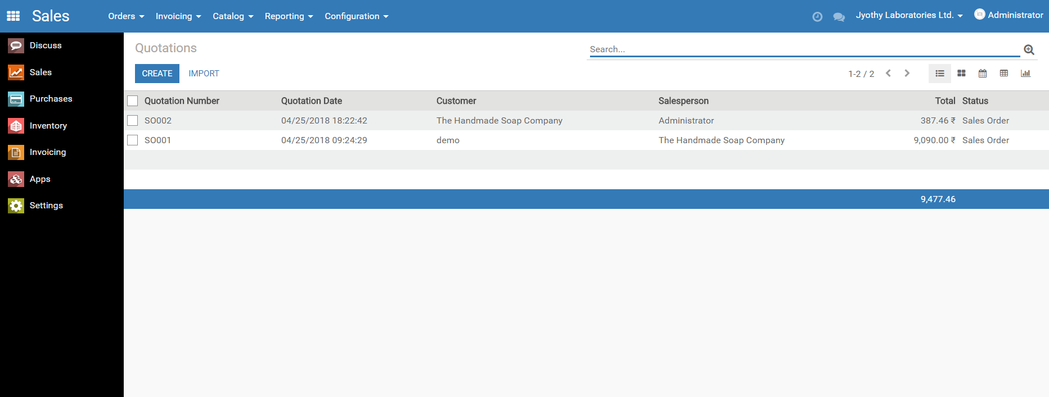
Odoo – Sales Order

Slide 16
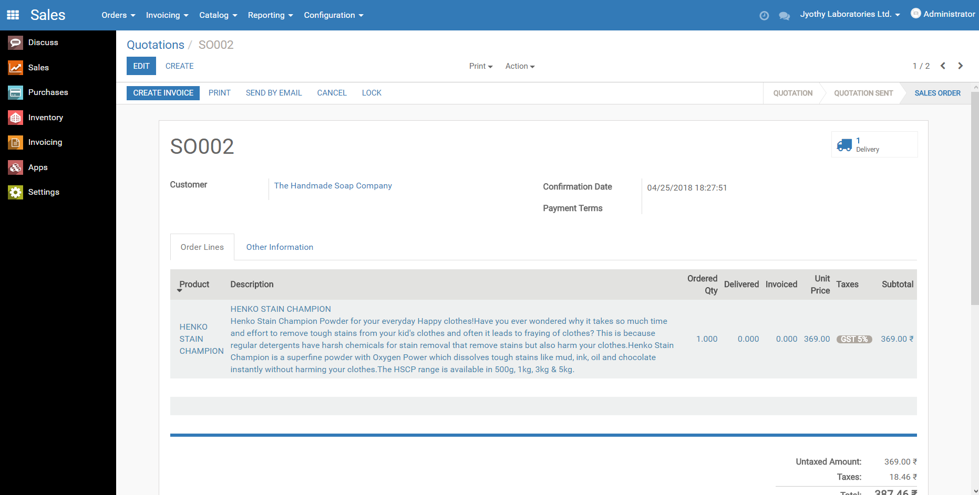
Odoo – Sales Order

Slide 17
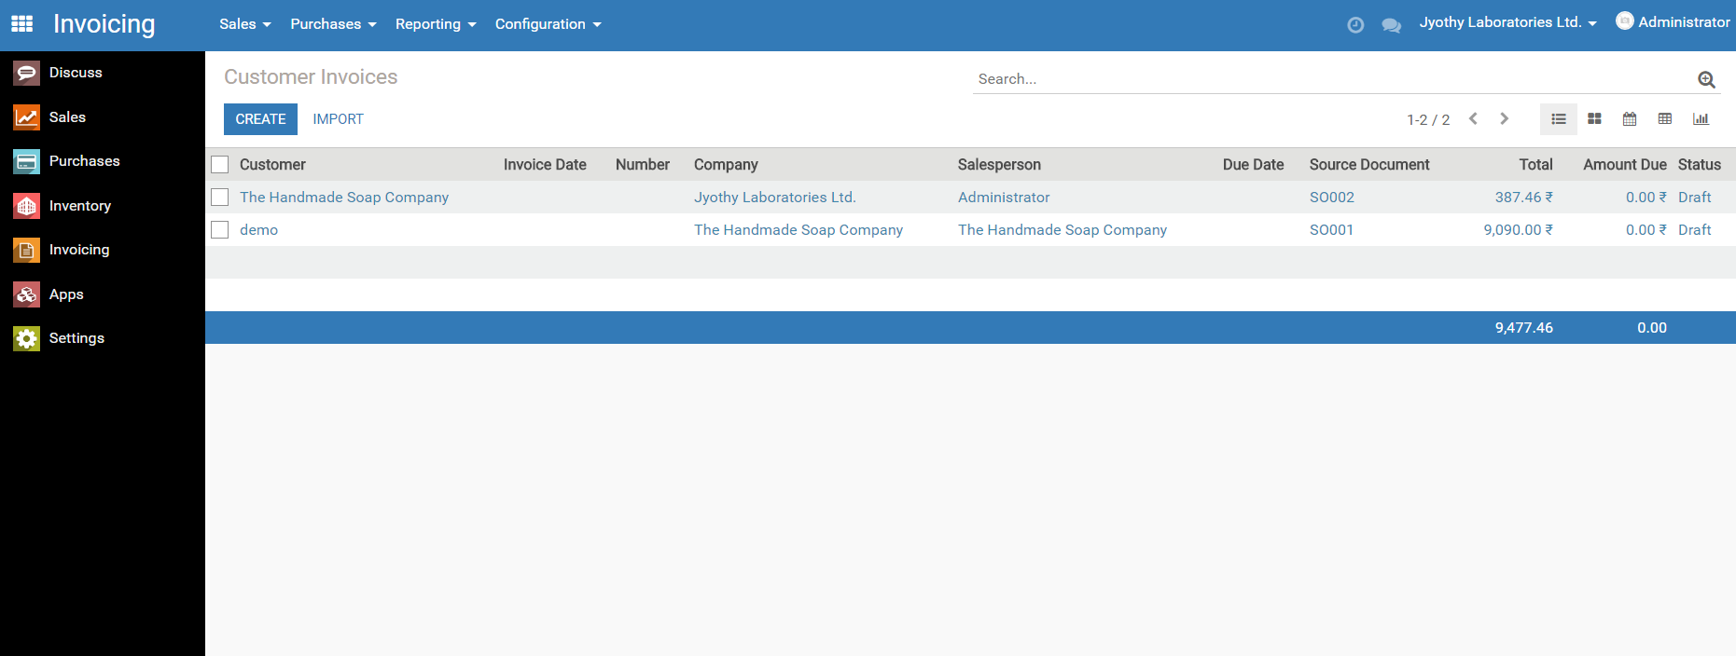
Odoo - Invoice

Slide 18
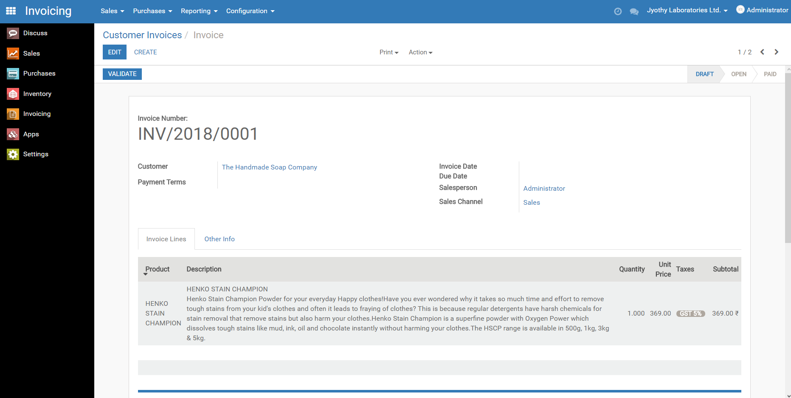
Odoo - Invoice

Slide 19
Thank You
Satish Gaonkar, Orient Technologies Pvt. Ltd.

